Slide 1




Positive Leadership
Perspectives and practices

Slide 2
Learning Objectives
Review the components of the Positive Workplace Framework (PWF): Mental Fitness and Resilience Practices.
Apply the principles of Positive Leadership to promote positive workplace cultures.

Slide 3
Overview of session
Review of the PWF
Principles of positive leadership
Assumptions related to positive leadership
Positive Leadership Strategies
  Leadership Virtues
  Energizing Skills
  Positive Communication
  Motivational Knowledge and Skills
  Operational Tasks
Practice Activity

Slide 4
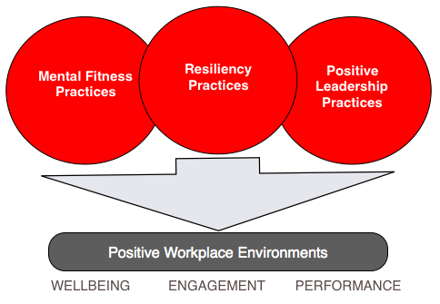
Positive Workplace framework

Slide 5
Positive approaches
Recent better practice research in workplace wellness is demonstrating the importance of moving beyond a problem-focused approach to embrace a more positive view of people, their potential and motivations.
Positive leadership refers to an emphasis on:
  What elevates individuals and organizations (in addition to what challenges them)
  What goes right in organizations (in addition to what goes wrong)
  What is life-giving (in addition to what is problematic or life-depleting)
  What is experienced as good (in addition to what is objectionable)
  What is extraordinary (in addition to what is merely effective), and what is inspiring (in addition to what is difficult or arduous)

Slide 6

Assumptions related to positive Leadership
People have inner strengths and gifts that support their capacity to initiate, direct and sustain positive work and life directions (Hamilton & Hamilton, 2004; Losier and Morrison, 2007).
Engagement and empowerment are critical considerations for facilitating positive development or change (CSPH, 2002; Deci & Ryan, 2007).

Slide 7
Assumptions related to positive Leadership
Social contexts and networks provide important resources and influences that have the capacity to contribute to and enhance psychological wellbeing.
People’s relationships with others that contribute to psychological wellbeing are characterized by interactions that convey genuineness, empathy, unconditional caring and affirmation.

Slide 8
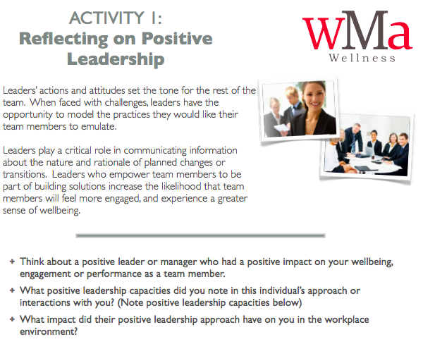
Practice activity

Slide 9
positive leadership strategies
Adapted from Cameron 2012

Slide 10
1. Leadership Virtues in Action
Leadership Virtues in Action refers to the capacity for a leader to show gratitude, compassion and forgiveness to employees.
“When leaders fostered compassionate behavior among employees, enabled forgiveness for missteps and mistakes, and encouraged frequent expressions of gratitude, organizations’ profitability, productivity, quality, innovation, customer satisfaction, and employee retention were significantly higher than in other organizations. Leaders who reinforced these virtuous behaviors were more successful in producing bottom-line results than typical leaders” (Cameron, 2012).

Slide 11
Compassion in Action
Kanov and colleagues (2004) identified three key actionable processes that enable organizational compassion:
  Collective noticing: Tightly knit communities and groups that share a common value system tend to notice one another, keep track of one another, and detect one another’s difficulties.
  Collective feeling: Employees are encouraged to express concern and care for one another both with respect to work and personal challenges people are experiencing.
  Collective responding: Employee teams are encouraged to care for one another and to take compassionate and caring actions when members are in need or encounter overwhelming circumstances.

Slide 12
Forgiveness in Action
Acknowledge areas of challenge, mishaps and mistakes, and even injustices.
Encourage mutual opportunities for restoration at all levels beginning with in-person dialogue and professional responsibility for forgiving and being forgiven.
Frame difficult events as potential starting points for more positive goals and future.
Provide support to individuals by communicating that human development and welfare are important organizational priorities.

Slide 13
Gratitude in Action
Emmons (2003) found that expressions of gratitude by one person tended to motivate others to express gratitude.
The following actions have been shown in empirical investigations to produce important impacts with respect organizational climate (Seligman, Steen, Park & Peterson, 2005).
Engaging in gratitude visits to express thankfulness or appreciation
Keeping gratitude journals (writing down three things daily for which you are grateful)
Distributing daily gratitude cards (e.g., handing out five written expressions of appreciation to coworkers each day)

Slide 14
2. Energizing skills
Research has highlighted that individuals can be identified as 'positive energizers’ or 'negative energizers’, and that the difference has important implications.
Positive energizers create and support vitality in others. They uplift and boost people.
Interacting with positive energizers leaves others feeling lively and motivated - They build energy in people.

Slide 15
Positive Energizers…
Connect with others, smile and like people
Make time to listen and give full attention to others
Are fully engaged in conversations
See beyond roadblocks and suspend immediate judgment
Problem-solve, work around challenges and be flexible
Create opportunities for others to grow and develop
Value others and promote their accomplishments
Follow through on commitments and keep their word

Slide 16
Energizing Others Using Strengths
Leaders can energize teams by reinforcing individual and organizational strengths.
Identifying and building on people’s strengths can produce greater benefit than finding and correcting their weaknesses.

Slide 17
3. Positive communication
Positive communication occurs in organizations when supportive and affirmative language replaces negative and critical language.
As discovered by Fredrickson and Losada (2005), a ratio of between 3 and approximately 8 positive statements to every 1 negative statement is predictive of the highest levels of workplace performance.
Leaders enable positive communication by using positive talk themselves.

Slide 18
Supportive Communication
Supportive communication seeks to preserve, support and enhance a positive relationship while still addressing areas of concern or challenge, or areas of needed development.
Supportive communication is….
Honest and congruent
Descriptive
Specific
Reflective

Slide 19
4. Motivational knowledge and skills
Motivational Knowledge refers to leaders’ awareness of employee strengths and interests.
Motivational Skills refer to the capacity of leaders to engage employee strengths and interests within workplace routines and activities.
  When employees are personally engaged, they experience a greater sense of wellbeing within the workplace environment (Brown, Nesse, Vinokur, & Smith, 2003; Grant, 2008; Grant et al., 2007).

Slide 20
Motivational Knowledge and Skills
Applying motivational knowledge and skills can let to a sense of “flow” among employees, even when involved in challenging tasks. Flow occurs most frequently when tasks are closely aligned with employee goals.
Leaders who apply motivational knowledge and skills promote a shared vision and encourage a personal investment on the part of employees in corporate success.

Slide 21
5. Operational tasks
Operational Tasks refers to the ability of the manager to keep employees feeling engaged with holding regular meetings and offering clarity of roles. Role clarity provides a needed foundation for supporting the use of positive leadership strategies.

Slide 22
Team Building and Professional Learning
On-on-One Sessions
Regular one-on-one meetings between leaders and their team members provide a forum within which to reinforce and practice positive leadership strategies. One-time role-negotiation sessions with each employee can clarify goals, expectations, important organizational or team considerations, and areas of responsibility.
Positive leadership strategies impact workplace culture when they are applied by all team members.
Collective learning sessions provide a forum for moving positive leadership strategies from pre-contemplation to contemplation to action within and across organizational teams.

Slide 23


Application Activity
Positive Leadership Inventory
At the close of the workshop, complete the Positive Leadership Inventory. Following the self-scoring instructions, calculate your outcomes for each of the leadership strategies.
Share with a colleague your results, and discuss which strategies you use most in your current workplace routines and relationships.
Take time to reflect on the positive leadership strategies you would like to further develop in the future.

Slide 24
Role of PWF Trainers
Promote awareness of Positive Workplace concepts and practices (Mental Fitness, Resiliency Practices and Positive Leadership Practices)
Use the available online resources to build awareness of PWF practices among team members in their roles and interactions with others.
Embed PWF practices within routines and relationships in the workplace (Be a role model for others).

Slide 25
Online resources
Resources that promote positive mental health practices (Mental Fitness, Resiliency, Positive Leadership)
Modules and eBooks
Mental Fitness and Resiliency Inventory (MFRI) and the checklists of potential actions
The Positive Leadership Inventory (PLI-360) and the checklists of potential actions
Presentation tools
Suggested action plan

Slide 26
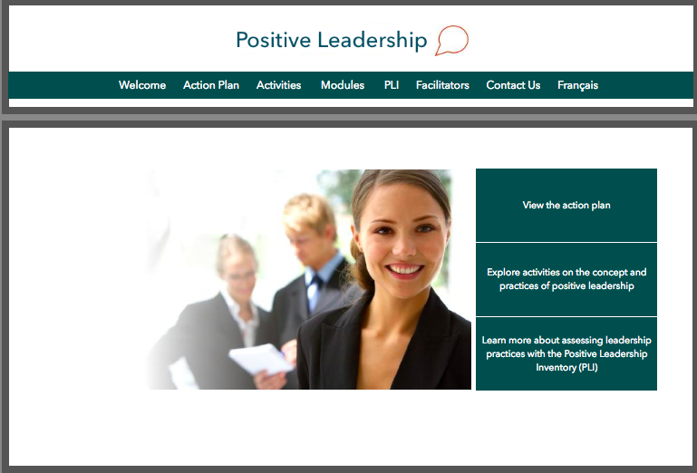

Slide 27
Thank you!

